Slide 1
WEEK 18
CESAR A. PASCAL VASQUEZ

Slide 2
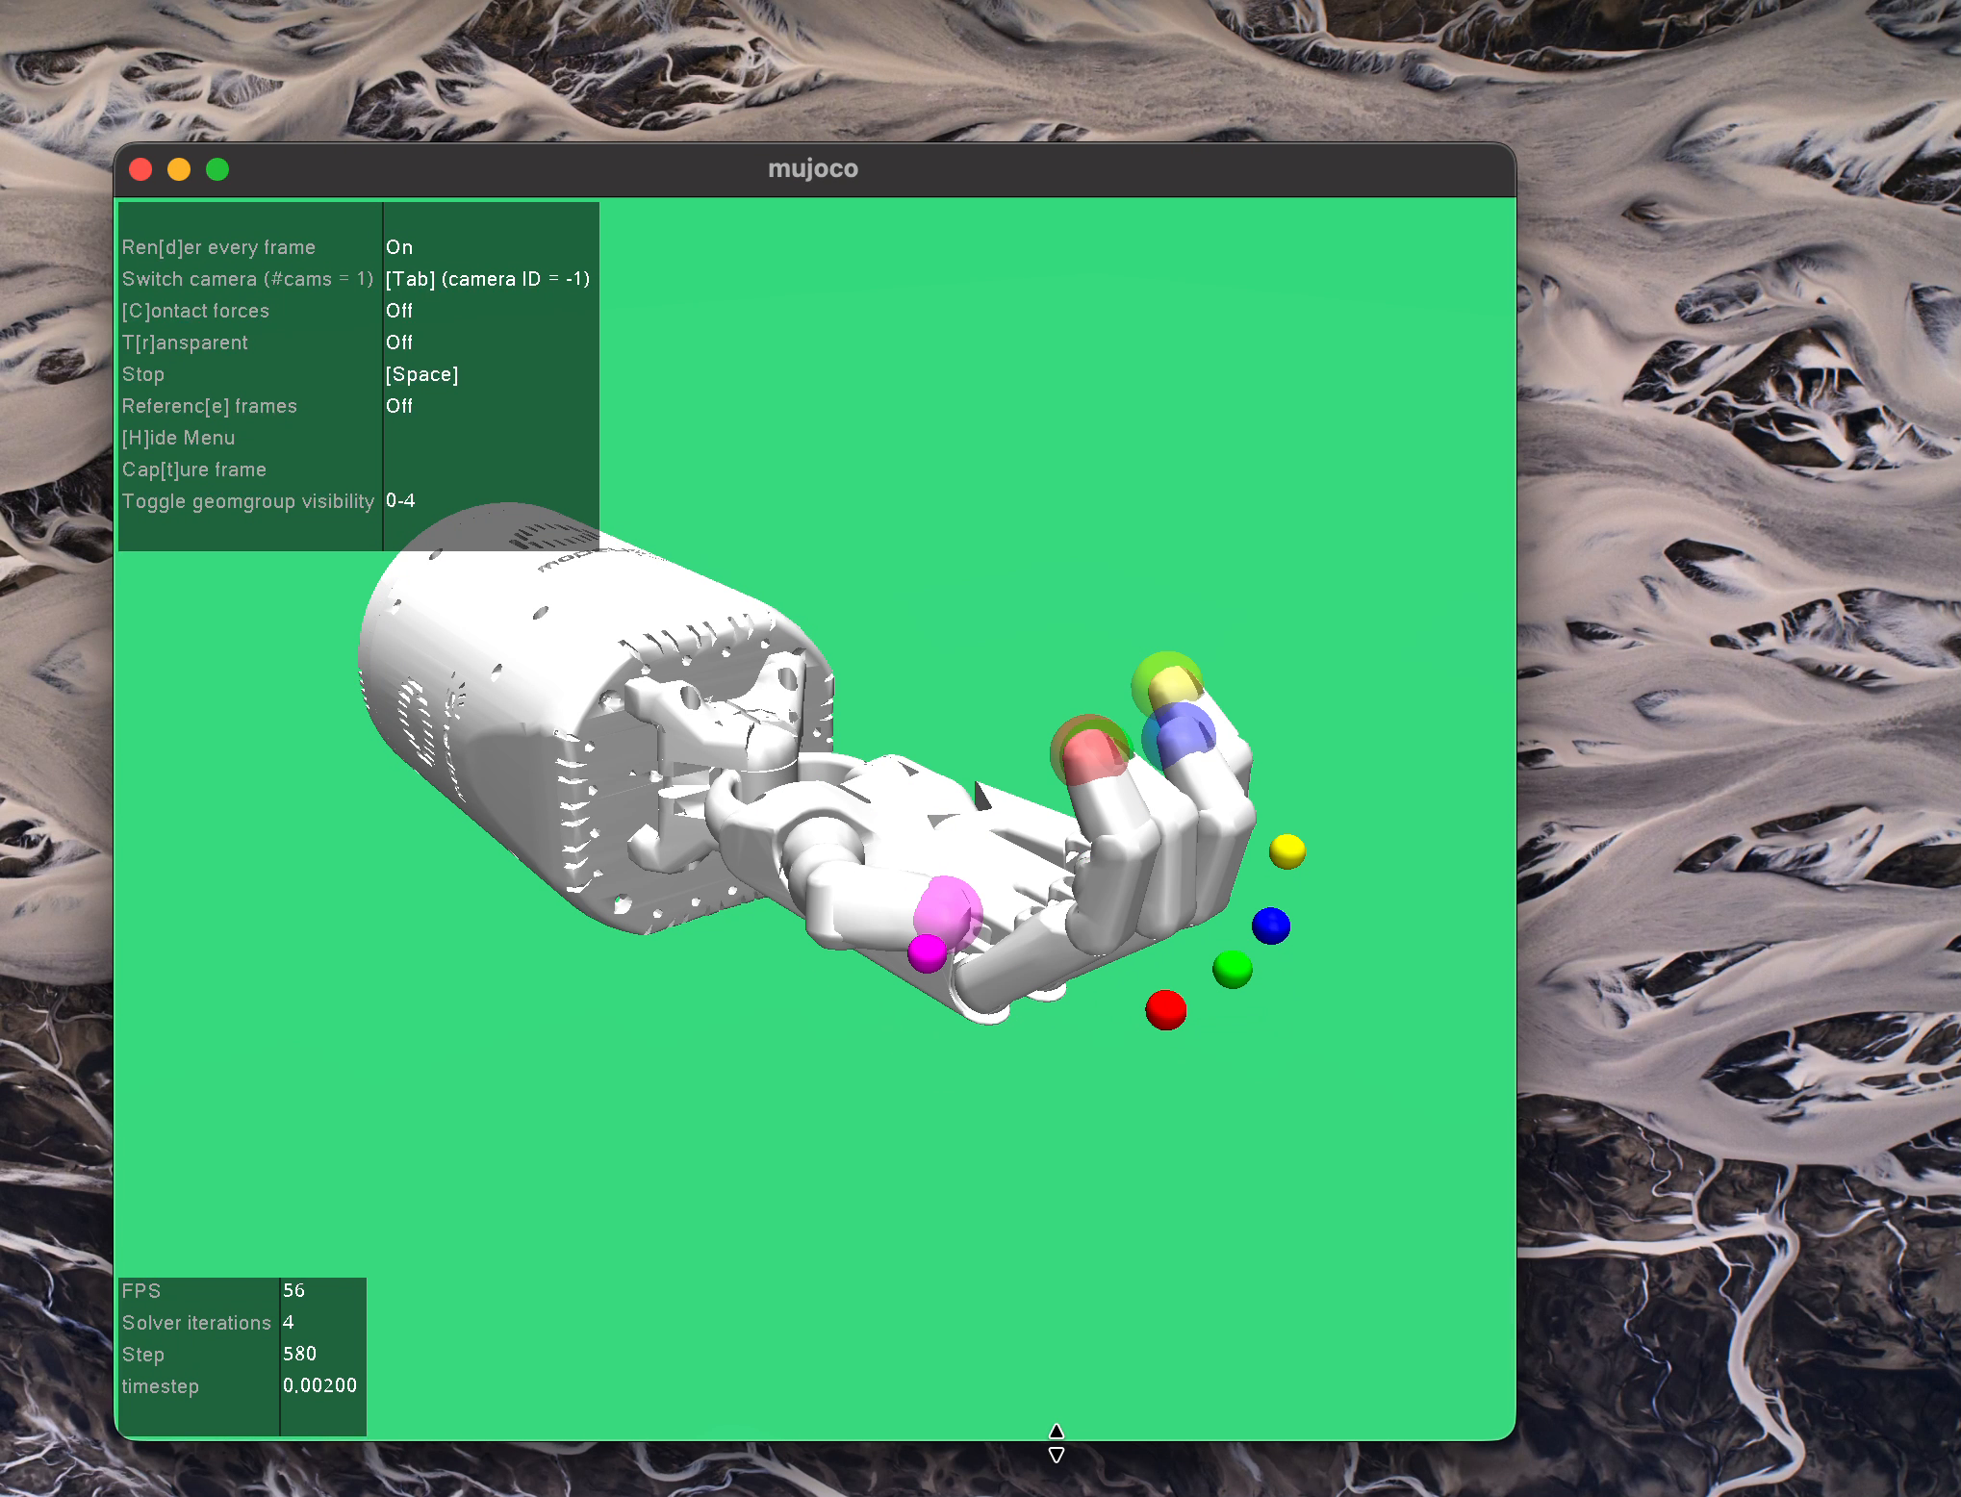
This week, the focus shifted from robotic arm training to robotic hand control.
After testing robotic arm movement in MuJoCo, I began working with a dexterous robotic hand environment. The goal was to train a policy that can control the fingers and move the fingertips toward target positions. This is a useful first step before moving into harder manipulation tasks, such as grasping or rotating an object.
MuJoCo Shadow Hand reach environment used for robotic hand policy testing.
Week 18 | 2

Slide 3
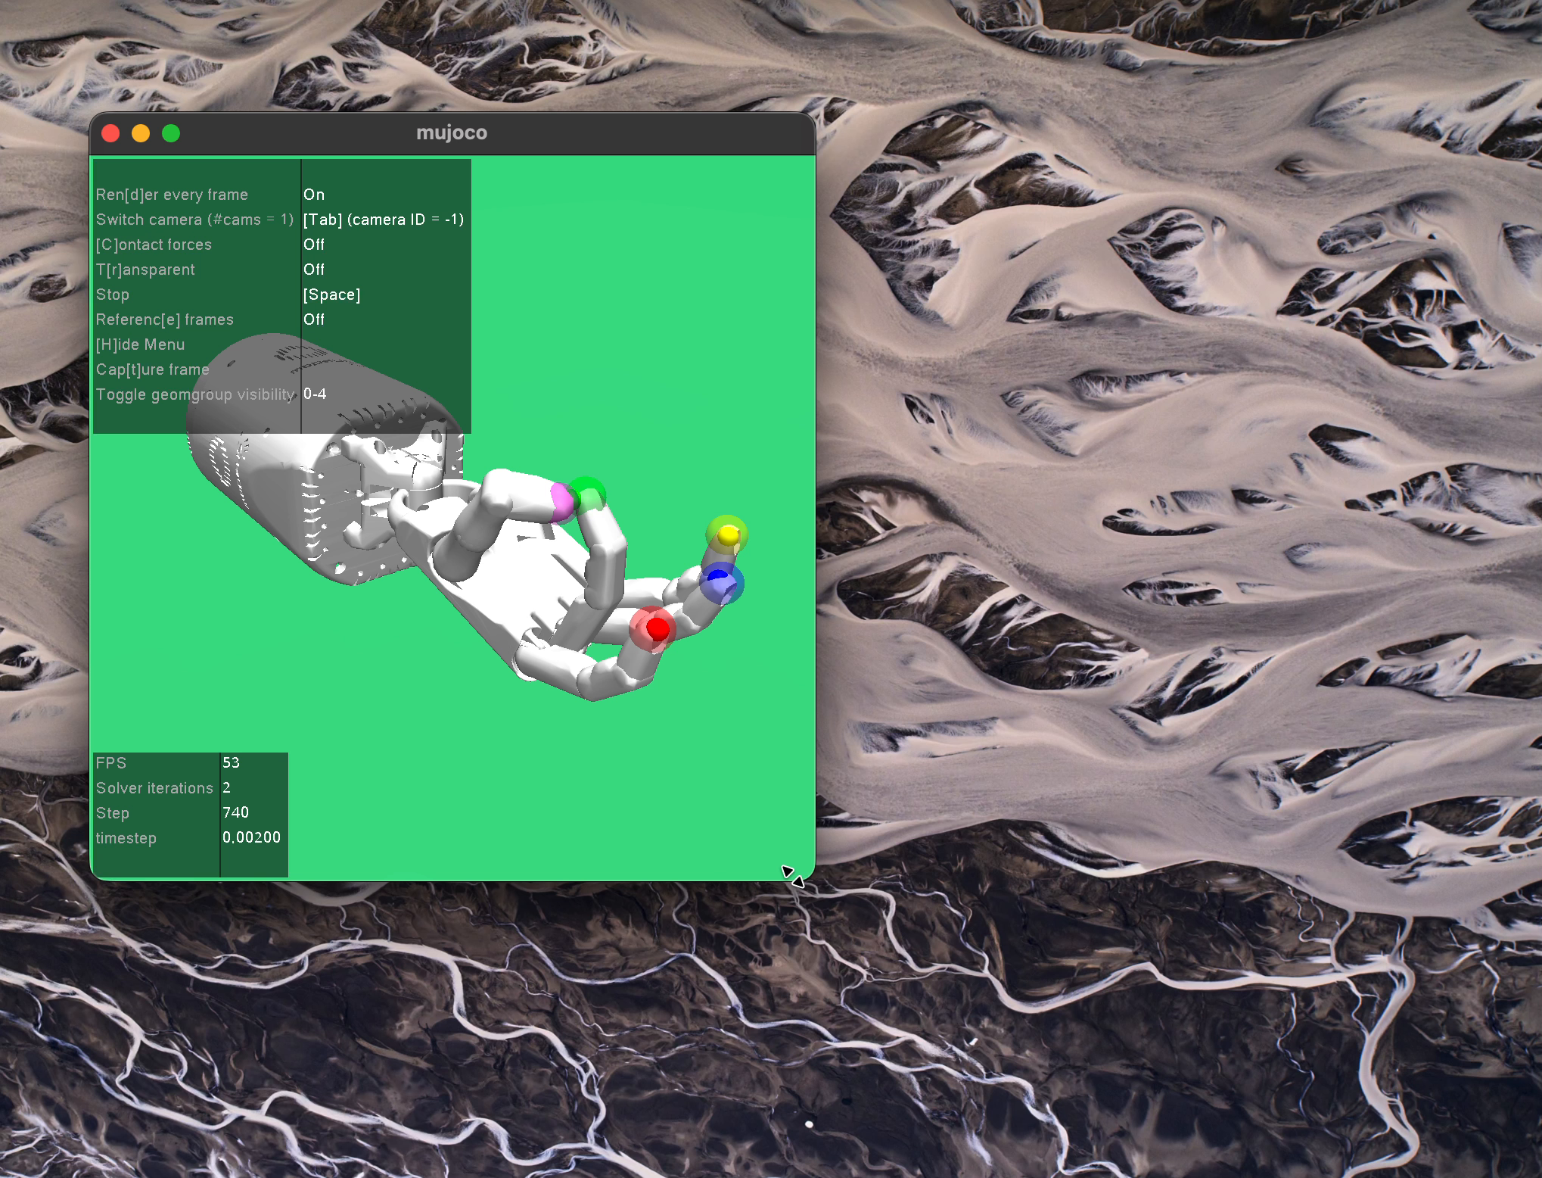
The environment used for this experiment was HandReachDense-v3.
The Shadow Hand environment gives the policy a target position for each fingertip. The policy must control the hand joints so that the fingertips move closer to the colored goals. I used the dense version because it gives continuous feedback based on distance, which makes early learning easier than a sparse success-only reward.
• Environment: HandReachDense-v3
• Simulator: MuJoCo
• Task: move fingertips toward target spheres
• Reward: dense distance-based feedback
Colored targets show the desired fingertip positions.
Week 18 | 3

Slide 4
The policy was trained with SAC using dictionary observations.
Because the environment observation includes regular observations, achieved goals, and desired goals, I used a MultiInputPolicy. The training was kept small so it could run on CPU, but it was enough to confirm that the policy started learning meaningful finger movement.
• Algorithm: Soft Actor-Critic (SAC)
• Policy type: MultiInputPolicy
• Training length: 200,000 timesteps
• Episode length: 50 steps
• Hardware limitation: CPU training on Mac
Week 18 | 4

Slide 5
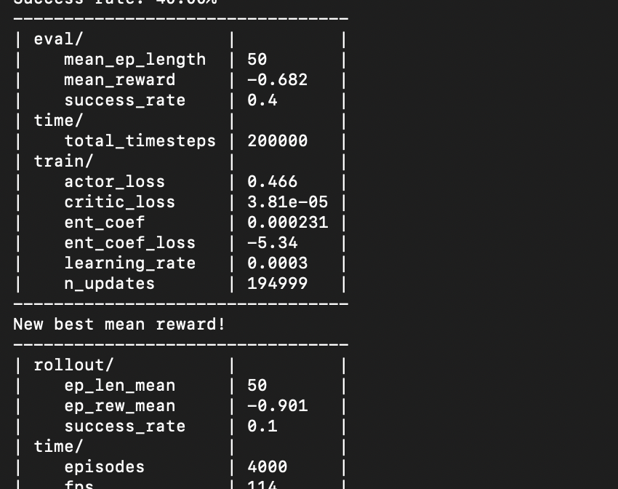
At 200,000 timesteps, the evaluation reached a 40% success rate.
40%
-0.682
eval success rate
mean reward
50
200k
episode length
timesteps
The best evaluation result showed a mean reward of about −0.68 and a 40% success rate. The rollout success rate was still lower, which means the policy learned some correct behavior but was not yet fully stable across every episode.
Training terminal output showing evaluation metrics after 200,000 timesteps.
Week 18 | 5

Slide 6
Policy visualization: the hand begins coordinating finger motion.
Video 1: MuJoCo playback showing the robotic hand moving the fingers toward the targets.
Week 18 | 6

Slide 7
A longer playback shows the trained hand continuing to track fingertip goals.
Video 2: trained policy behavior during a longer hand reach rollout.
Week 18 | 7

Slide 8
The main takeaway is that the hand policy is learning, but it still needs more training.
The 40% evaluation success rate shows that the policy is no longer random. It has learned to move several fingertips toward their target positions. However, the difference between evaluation success and rollout success suggests that the behavior is still inconsistent and needs more stable training before moving to object manipulation.
• Positive result: the hand can produce coordinated finger movement
• Current limitation: behavior is not fully stable across rollouts
• Important lesson: dense rewards help early dexterous-hand learning
• Next challenge: move from reaching to grasping or manipulating objects
Week 18 | 8

Slide 9
Next steps are to improve stability and move toward manipulation.
The next step is to train the policy for a longer period and compare the success rate over time. After the hand reach task becomes more reliable, the training can move to more advanced tasks such as block manipulation, pen rotation, or grasping. A GPU or a parallel environment setup would make this process faster and more stable.
• Increase total training timesteps
• Track success rate and mean reward across checkpoints
• Test HER or other goal-based reinforcement-learning methods
• Move from HandReachDense-v3 to manipulation environments
Week 18 | 9

Slide 10
References
Farama Foundation. Gymnasium-Robotics: Shadow Dexterous Hand Environments.
Raffin, A., Hill, A., Gleave, A., Kanervisto, A., Ernestus, M., & Dormann, N. Stable-Baselines3: Reliable Reinforcement Learning Implementations.
Todorov, E., Erez, T., & Tassa, Y. (2012). MuJoCo: A physics engine for model-based control. IEEE/RSJ International Conference on Intelligent Robots and Systems.
Week 18 | 10

